Slide 1
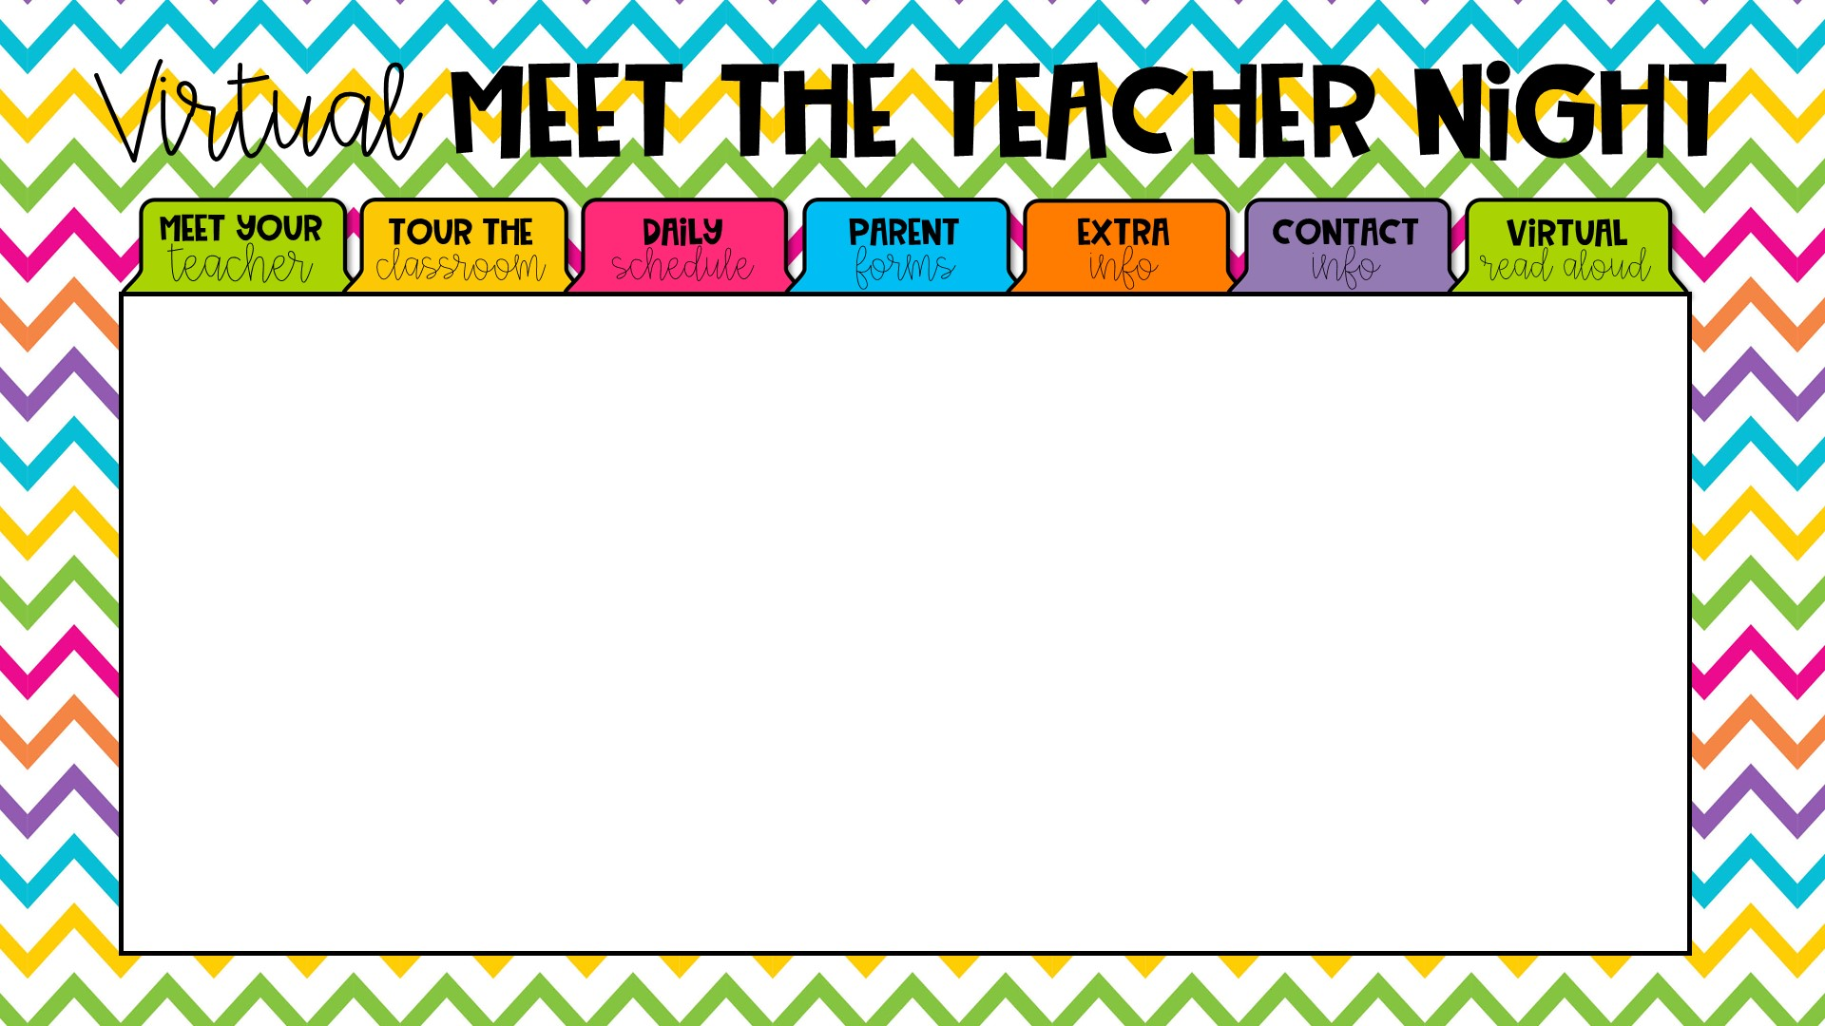

Welcome to Ms. Norton’s Virtual Orientation! I am super excited to have your child in my First Grade class this year. As we all know, this
year has required us to do things a little differently than normal. Although I wish that this meet and greet could be in person, I have included all of the information virtually for you.
This will be a Great Year!
Love, Ms. Norton

Slide 2
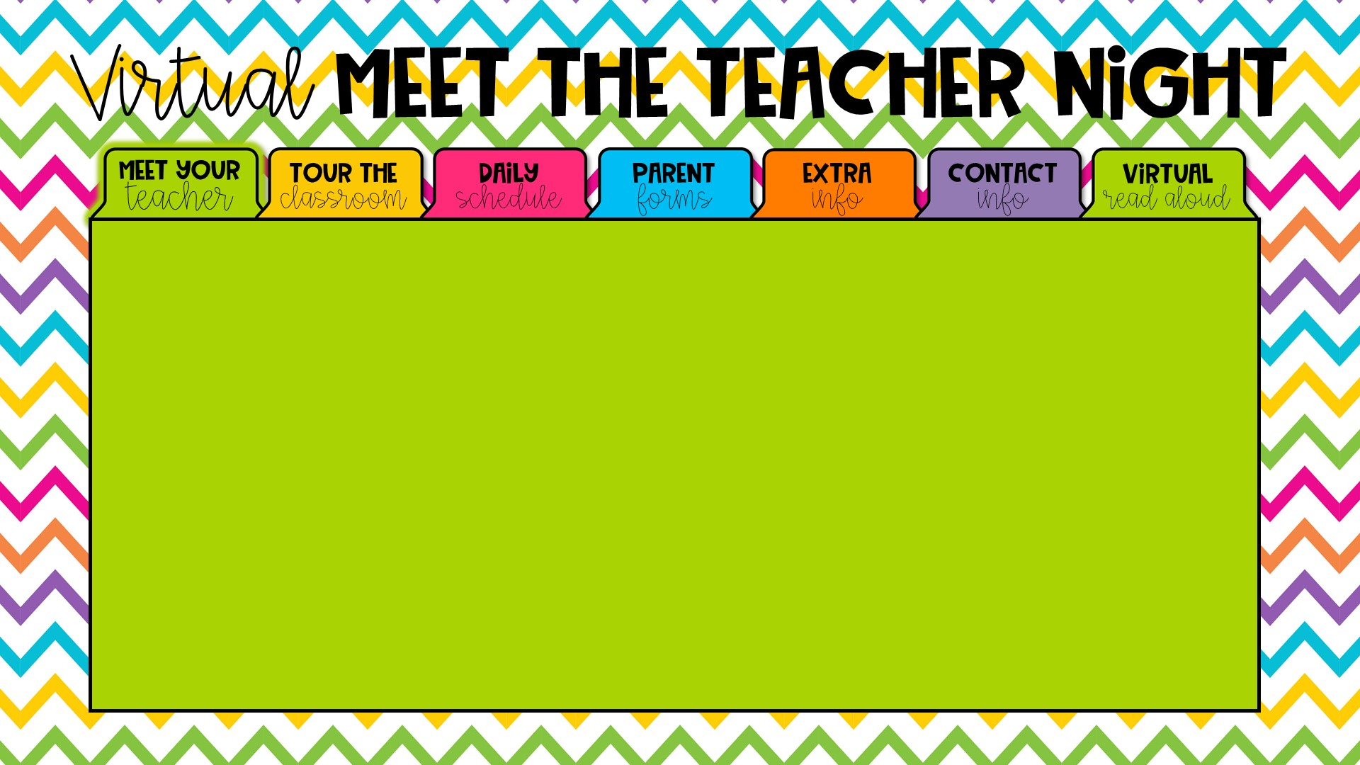

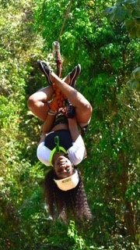


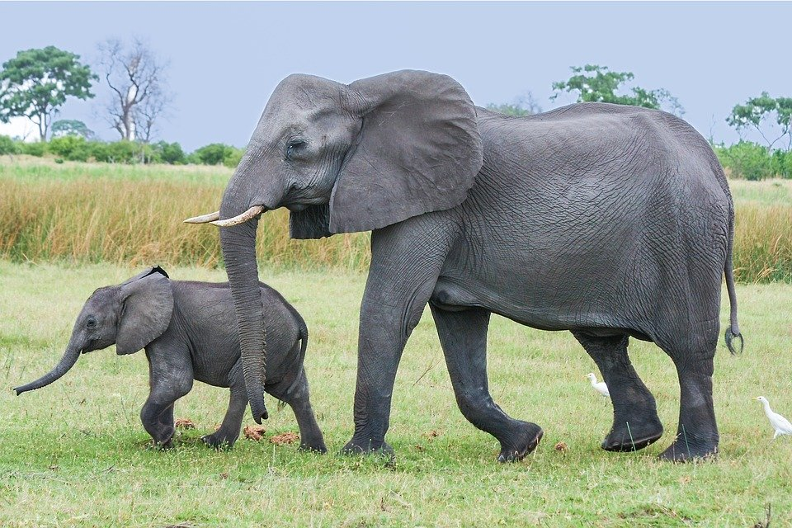



Hi parents and students, I am Ms. Norton.
Hope you’re hangin’ in there☺
I have spoken with most of you and as promised, here’s a face to put with a name. This will be my first year teaching and I’m excited to meet each and every one of you. I am a Flagler Graduate, born and raised in Tallahassee, Florida.
Some of my favorite things are:

Slide 3
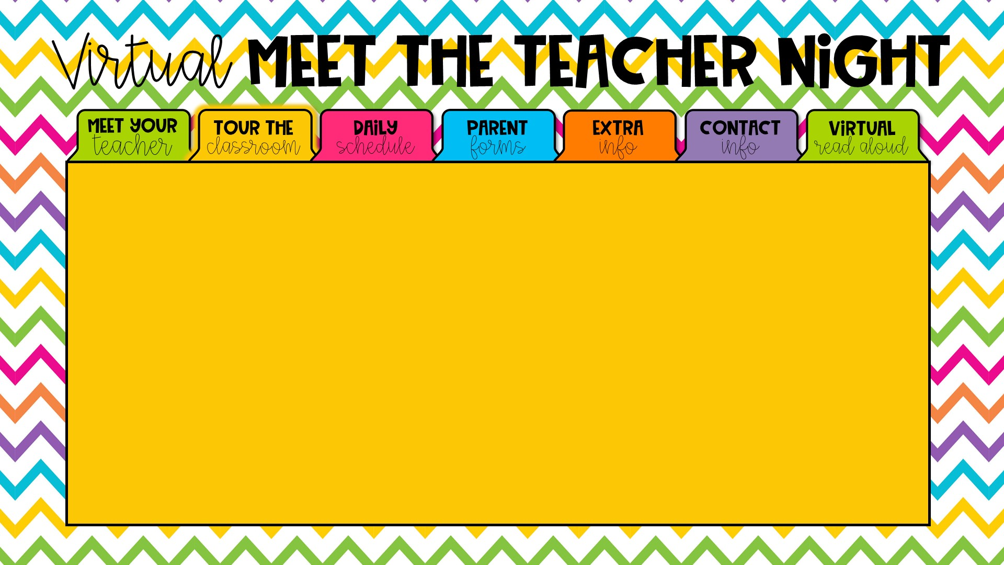
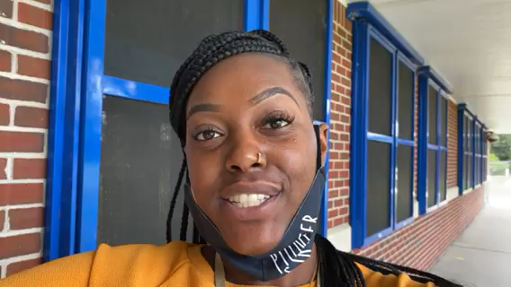

Hello, first graders!!! Welcome to Ms. Norton's Class!!
Click video below for a virtual tour of our classroom.

Slide 4



Daily Schedule
My Class Schedule is a work in progress, but I will let you know the finalized times as soon as everything is set. For my Digital Academy students, I will be there to assist every step of the way. This is new to us all, but I’ll try to make things as easy and user friendly as possible. The first grade team will be pre-recording a daily “check-in” time (TBA) where out friends at home can see our friends in class and interact, virtually. Leon County is still working very hard to get computers out to those of you who need them.
For my students reporting to school physically, things will look differently. Special Area will be coming into my classroom (except PE) to minimize traffic. Breakfast and Lunch will also take place inside my classroom. You are welcomed to send snacks with your child’s name on them. Please feel free to reach out to me if there are any questions or concerns. All ways of communicating can be found under the ”Contact Info” tab.

Slide 5
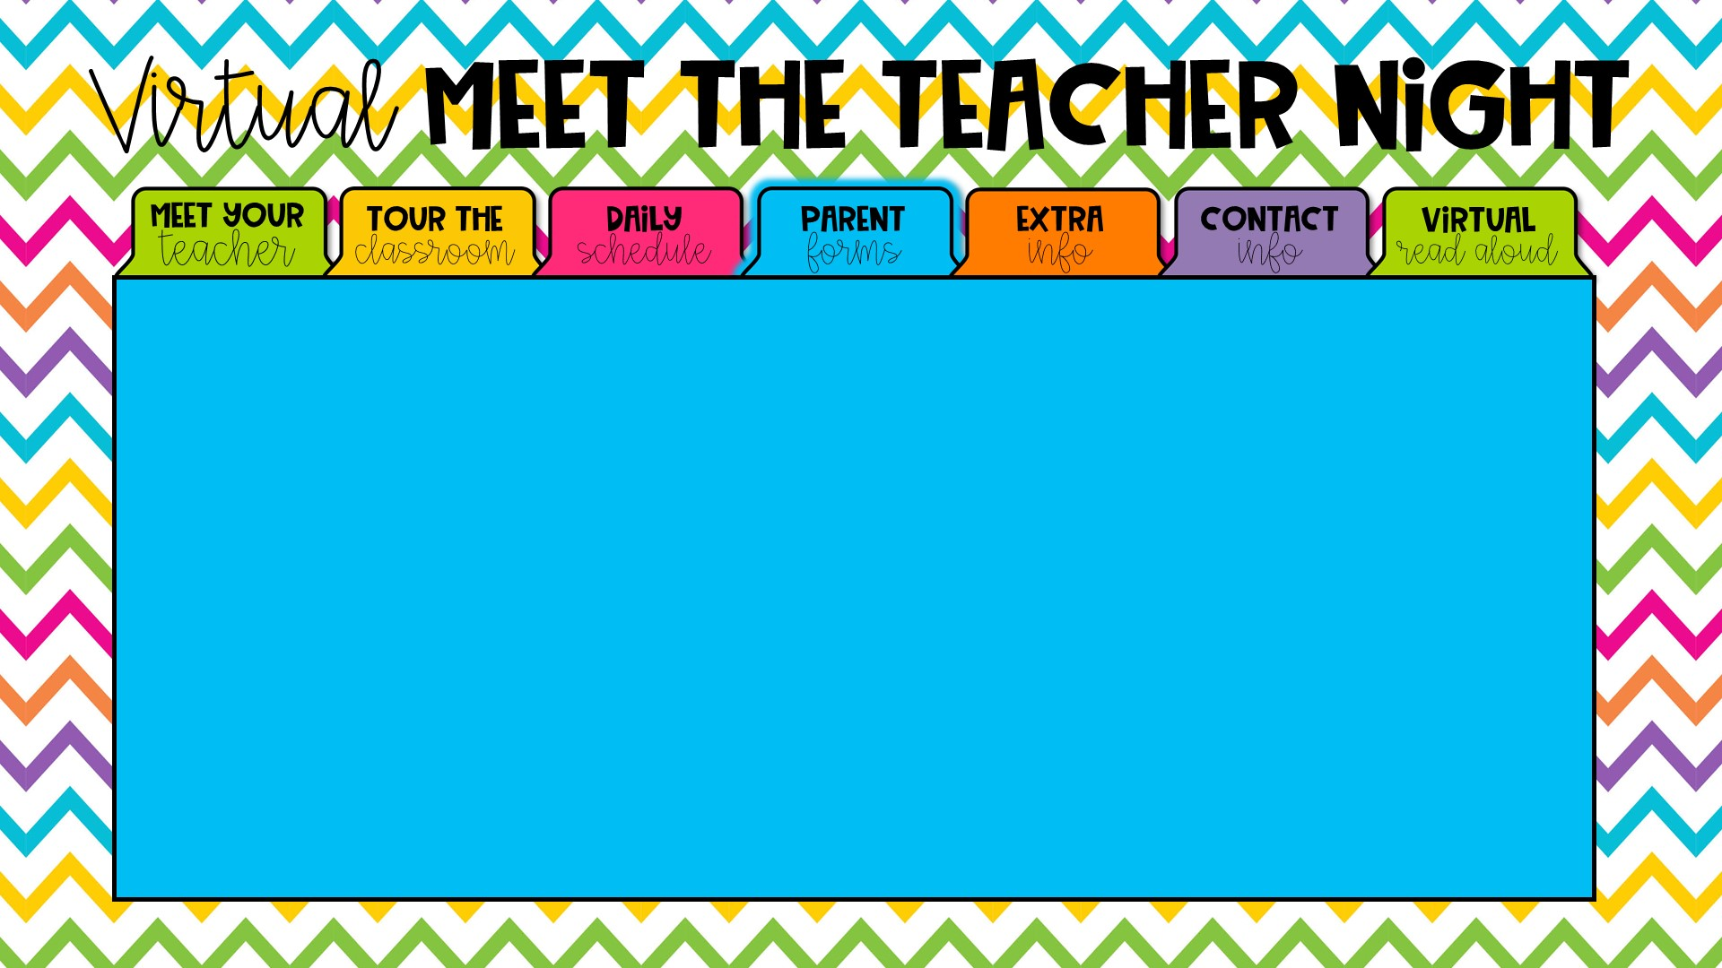

All required school forms are online, in your Parent Portal Focus account-which is on Fort Braden website. Please try to log in and make sure that everything is complete. If you have any questions, please contact me and I will do my best to help you with it. If there is anything that I need you to fill out, i will let you know ahead of time and send it via the Remind app or through email.

Slide 6
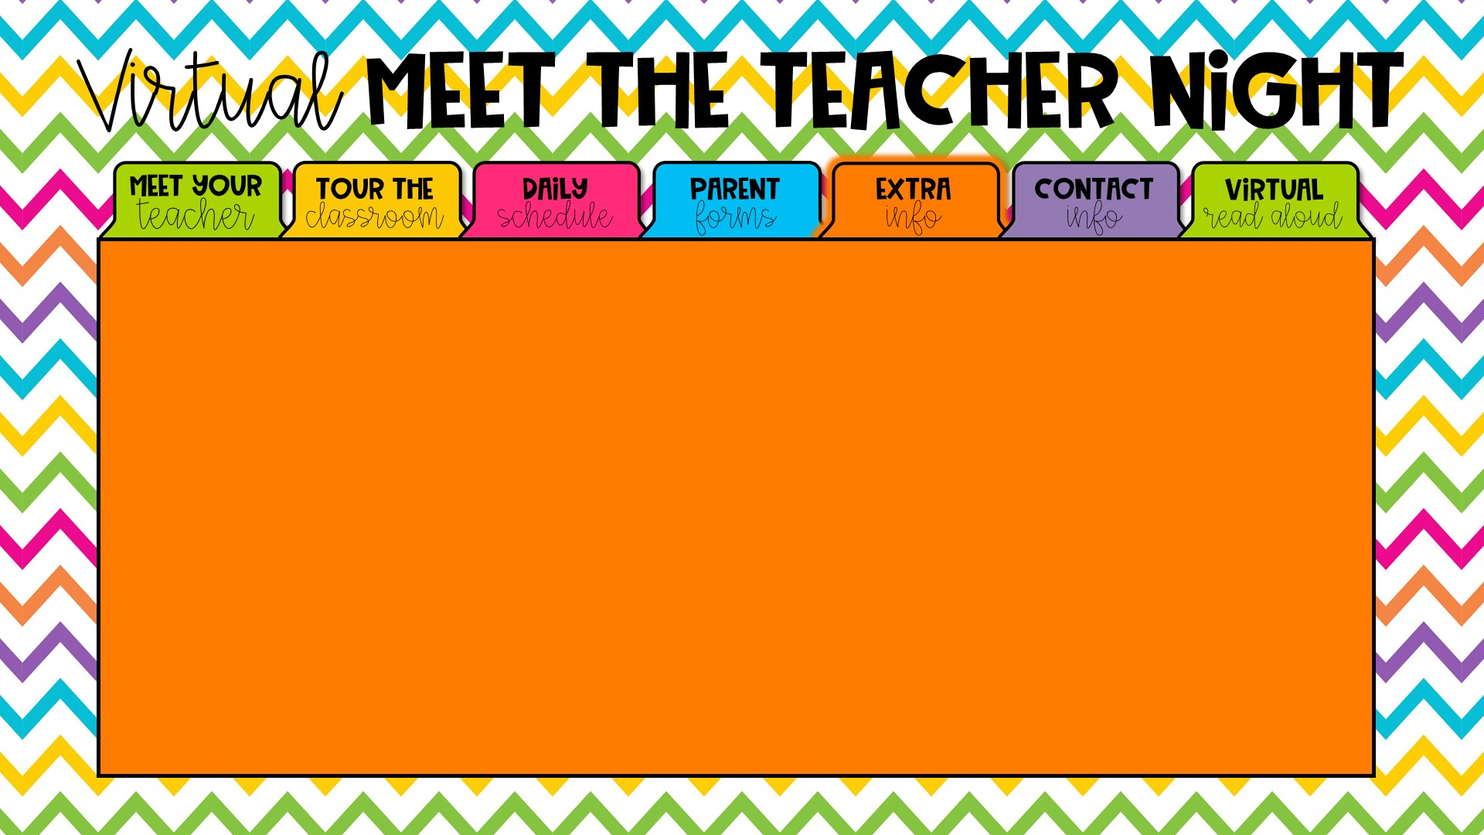
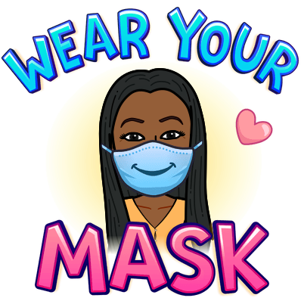
Mandatory Mask Wearing
Fort Braden Students and Staff will be required to wear masks throughout the day (breaks will be implemented). No bandanas, gators (turtleneck style masks)or masks with ventilation holes will be permitted. Please let me know if your child may be in need of a mask.

Slide 7
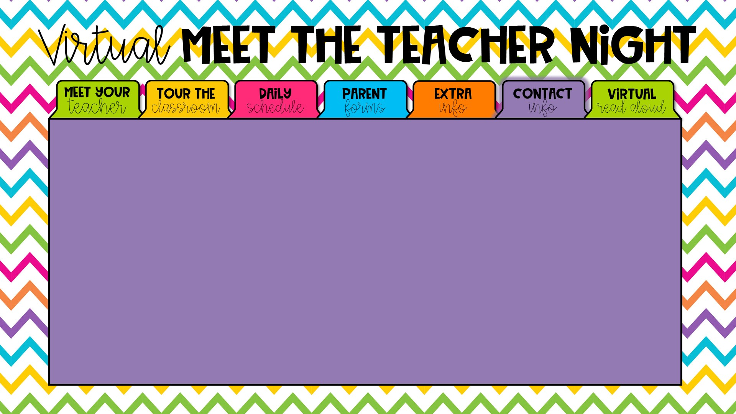



The school phone number is 850-488-9374. My planning time is from 10:00-10:40 this is typically the best time to reach me. I can also be reached via email at nortonl2@leonschools.net
In person meetings/conferences can be scheduled by appointment, by contacting the front office. “Teams” is also an option for virtual meetings.
The ”Remind App” pictured below is a great form of communication. This app allows parents to send messages via text.

Slide 8
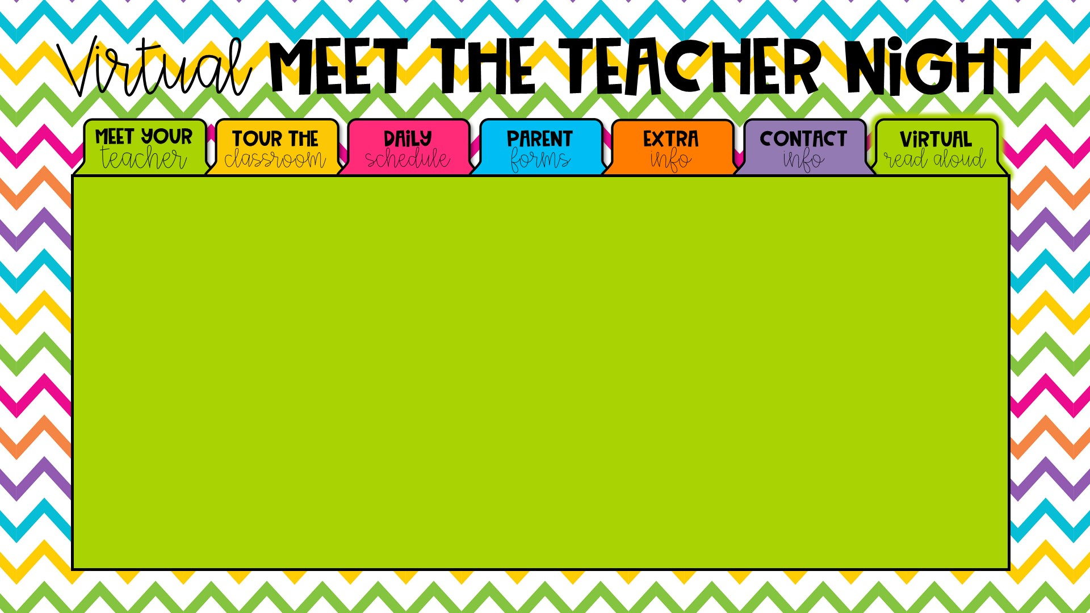



The first day of school's read aloud will be from "The Kissing Hand".
I will be sending the DA students the same activities and supplies as our friends here in class.

Slide 9
Title I at Fort Braden- What is it?
TITLE I at Fort Braden – What is it?
Leon County Title I Program receives Federal funds to provide supplemental instruction to students of public schools, neglected or delinquent sites, non-public schools, and homeless children. Services are provided for all students school-wide at Fort Braden. All K-8 Title I schools have 60% or more of their students on free or reduced lunch as determined by an Annual Economic Survey. Services are also provided to all students at eligible, neglected, or delinquent sites including Capital City Youth Services, Father Flanagan's Boys and Girl's Town of North Florida, Florida Baptist Children's Home, Homeless, Disc Village/ADT, Leon County Detention Center, Leon County Jail, PACE Center for Girls, Devereux Residential Center, Tallahassee Marine Institute, and LCS Ghazvini Transition Center.
Leon County Title I school plans are written by individual school sites and are directly correlated to the School Improvement Plan.
Schools in Leon County use Title I funds to support federal, state and local goals reflected in individual school plans. Teachers, parents, administrators, students, and all stakeholders are involved in the development andimplementation of each school's plan. A strong parentalinvolvement component is integrated throughout the plan at each site and each school utilizes a Parent, Student and Teacher Compact.

